Slide 1

Cryptographic Hash Functions
Cryptography

Slide 2
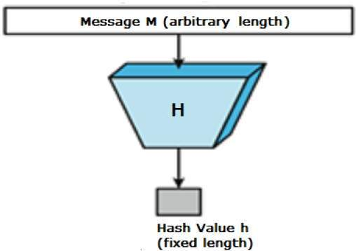
Hash Functions
Hash functions are extremely useful and appear in almost all information security applications.
A hash function is a mathematical function that converts a numerical input value into another compressed numerical value. The input to the hash function is of arbitrary length but output is always of fixed length.
Here H is a Hash Function

Slide 3
Hash Functions
Condenses arbitrary message to fixed size
h = H(M)
Usually assume that the hash function is public and not keyed
Hash used to detect changes to message
Can use in various ways with message
Most often to create a digital signature

Slide 4
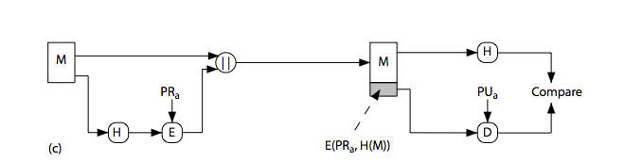
Hash Functions & Digital Signatures

Slide 5
Requirements for Hash Functions
Can be applied to any sized message M
Produces fixed-length output h
Is easy to compute h=H(M) for any message M
Given h is infeasible to find x s.t. H(x)=h
One-way property
Given x is infeasible to find y s.t. H(y)=H(x)
Weak collision resistance
Is infeasible to find any x,y s.t. H(y)=H(x)
Strong collision resistance

Slide 6
Birthday Problem
How many people do you need so that the probability of having two of them share the same birthday is > 50% ?
Random sample of n birthdays (input) taken from k (365, output)
k^{n} total number of possibilities
(k)_{n}=k(k-1)…(k-n+1) possibilities without duplicate birthday
Probability of no repetition:
p = (k)_{n}/k^{n} ≈ 1 - n(n-1)/2k
For k=366, minimum n = 23
n(n-1)/2 pairs, each pair has a probability 1/k of having the same output
n(n-1)/2k > 50% ➔ n>k^{1/2}

Slide 7
How Many Bits for Hash?
m bits, takes 2^{m/2} to find two with the same hash
64 bits, takes 2³² messages to search (doable)
Need at least 128 bits

Slide 8
Using Hash for Authentication
Alice to Bob: challenge r_{A}
Bob to Alice: MD(K_{AB}|r_{A})
Bob to Alice: r_{B}
Alice to Bob: MD(K_{AB}|r_{B})
Only need to compare MD results

Slide 9
Using Hash to Encrypt
One-time pad with K_{AB}
Compute bit streams using MD, and K
b₁=MD(K_{AB}), b_{i}=MD(K_{AB}|b_{i-1}), …
⊕ with message blocks
Is this a real one-time pad ?
Add a random 64 bit number (aka IV) b₁=MD(K_{AB}|IV), b_{i}=MD(K_{AB}|b_{i-1}), …

Slide 10
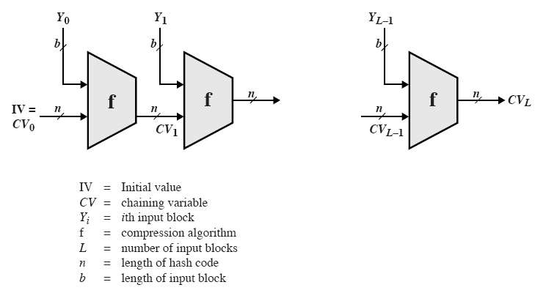
General Structure of Secure Hash Code
Iterative compression function
Each f is collision-resistant, so is the resulting hashing

Slide 11
MD5: Message Digest Version 5
input Message
Output 128 bits Digest
Until recently the most widely used hash algorithm
in recent times have both brute-force & cryptanalytic concerns
Specified as Internet standard RFC1321

Slide 12
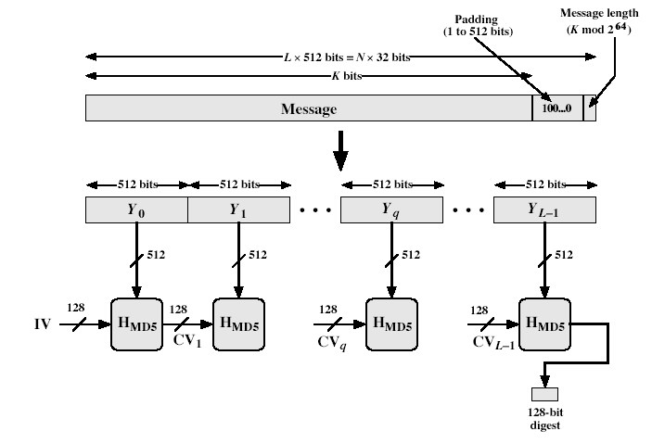
MD5 Overview
Notes:
Stallings Fig 12.1

Slide 13
MD5 Overview
Pad message so its length is 448 mod 512
Append a 64-bit original length value to message
Initialise 4-word (128-bit) MD buffer (A,B,C,D)
Process message in 16-word (512-bit) blocks:
Using 4 rounds of 16 bit operations on message block & buffer
Add output to buffer input to form new buffer value
Output hash value is the final buffer value
Notes:
The padded message is broken into 512-bit blocks, processed along with the buffer value using 4 rounds, and the result added to the input buffer to make the new buffer value. Repeat till run out of message, and use final buffer value as hash. nb. due to padding always have a full final block (with length in it).

Slide 14
Processing of Block m_{i} - 4 Passes
m_{i}
MD_{i}
ABCD=f_{F}(ABCD,m_{i},T[1..16])
A
B
C
D
ABCD=f_{G}(ABCD,m_{i},T[17..32])
ABCD=f_{H}(ABCD,m_{i},T[33..48])
ABCD=f_{I}(ABCD,m_{i},T[49..64])
+
+
+
+
MD _{i+1}

Slide 15
Padding Twist
Given original message M, add padding bits “10*” such that resulting length is 64 bits less than a multiple of 512 bits.
Append (original length in bits mod 2⁶⁴), represented in 64 bits to the padded message
Final message is chopped 512 bits a block

Slide 16
MD5 Process
As many stages as the number of 512-bit blocks in the final padded message
Digest: 4 32-bit words: MD=A|B|C|D
Every message block contains 16 32-bit words: m₀|m₁|m₂…|m₁₅
Digest MD₀ initialized to: A=01234567,B=89abcdef,C=fedcba98, D=76543210
Every stage consists of 4 passes over the message block, each modifying MD
Each block 4 rounds, each round 16 steps

Slide 17
Different Passes...
Each step i (1 <= i <= 64):
Input:
m_{i} – a 32-bit word from the message
With different shift every round
T_{i} – int(2³² * abs(sin(i)))
Provided a randomized set of 32-bit patterns, which eliminate any regularities in the input data
ABCD: current MD
Output:
ABCD: new MD

Slide 18
MD5 Compression Function
Each round has 16 steps of the form:
a = b+((a+g(b,c,d)+X[k]+T[i])<<<s)
a,b,c,d refer to the 4 words of the buffer, but used in varying permutations
note this updates 1 word only of the buffer
after 16 steps each word is updated 4 times
where g(b,c,d) is a different nonlinear function in each round (F,G,H,I)

Slide 19
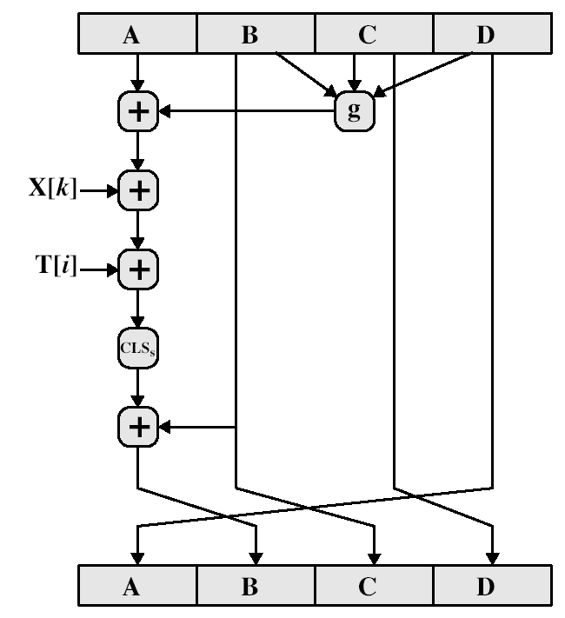
MD5 Compression Function

Slide 20
Functions and Random Numbers
F(x,y,z) == (x∧y)∨(~x ∧ z)
selection function
G(x,y,z) == (x ∧ z) ∨(y ∧~ z)
H(x,y,z) == x⊕y⊕ z
I(x,y,z) == y⊕(x ∧ ~z)

Slide 21
Secure Hash Algorithm
Developed by NIST, specified in the Secure Hash Standard (SHS, FIPS Pub 180), 1993
SHA is specified as the hash algorithm in the Digital Signature Standard (DSS), NIST

Slide 22
General Logic
Input message must be < 2⁶⁴ bits
not really a problem
Message is processed in 512-bit blocks sequentially
Message digest is 160 bits
SHA design is similar to MD5, a little slower, but a lot stronger

Slide 23
Basic Steps
Step1: Padding
Step2: Appending length as 64 bit unsigned
Step3: Initialize MD buffer 5 32-bit words
Store in big endian format, most significant bit in low address
A|B|C|D|E
A = 67452301
B = efcdab89
C = 98badcfe
D = 10325476
E = c3d2e1f0

Slide 24
Basic Steps...
Step 4: the 80-step processing of 512-bit blocks – 4 rounds, 20 steps each.
Each step t (0 <= t <= 79):
Input:
W_{t} – a 32-bit word from the message
K_{t} – a constant.
ABCDE: current MD.
Output:
ABCDE: new MD.

Slide 25
SHA-1 verses MD5
Brute force attack is harder (160 vs 128 bits for MD5)
A little slower than MD5 (80 vs 64 steps)
Both work well on a 32-bit architecture
Both designed as simple and compact for implementation
Cryptanalytic attacks
MD4/5: vulnerability discovered since its design
SHA-1: no until recent 2005 results raised concerns on its use in future applications
Notes:
Compare using the design goals listed earlier.
In 2005, a research team described an attack in which two separate messages could be found that deliver the same SHA-1 hash using 2^69 operations, far fewer than the 2^80 operations previously thought needed to find a collision with an SHA-1 hash [WANG05]. This result should hasten the transition to newer, longer versions of SHA.
In August 2005, an improved attack on SHA-1, discovered by Xiaoyun Wang, Andrew Yao and Frances Yao, was announced at the CRYPTO conference rump session. The time complexity of the new attack is claimed to be 263. But no collision on SHA-1 has been found yet.

Slide 26
SHA Versions

Slide 27
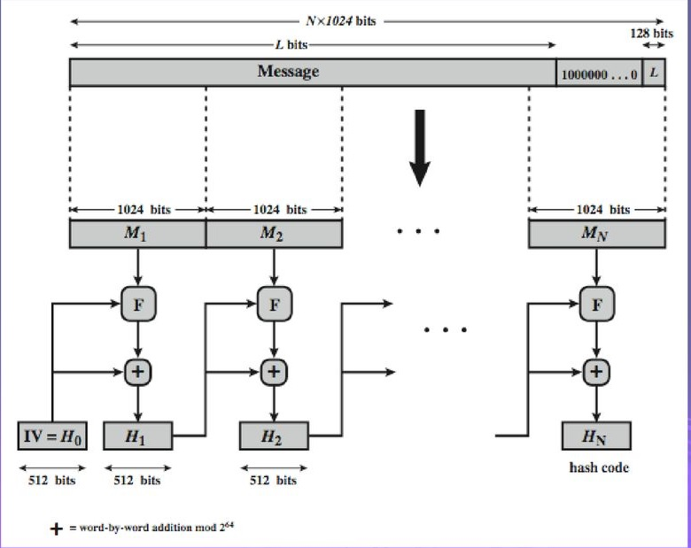
SHA-512

Slide 28
Revised Secure Hash Standard
NIST have issued a revision FIPS 180-2 in 2002
Adds 3 additional hash algorithms
SHA-256, SHA-384, SHA-512
Collectively called SHA-2
Designed for compatibility with increased security provided by the AES cipher
Structure & detail are similar to SHA-1
Hence analysis should be similar, but security levels are rather higher

Slide 29
Reference
Stallings, William, et al. Computer security: principles and practice. Upper Saddle River, NJ, USA: Pearson Education, 2012.

Slide 30
Thank you!

